Slide 1


Enhancing Metadata Retrieval in Life Sciences: LLM Integration with Semantic Search for Natural Language Queries.
Summer Program Internship 2024
Student: Cédric Daumas
Supervisor: Norio Kobayashi-sensei

Slide 2
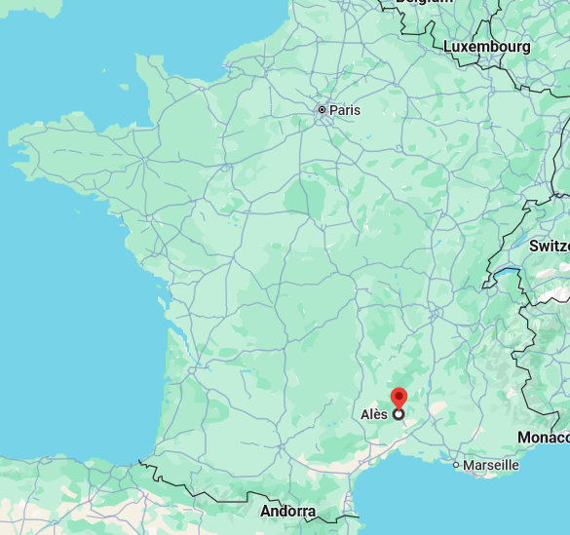
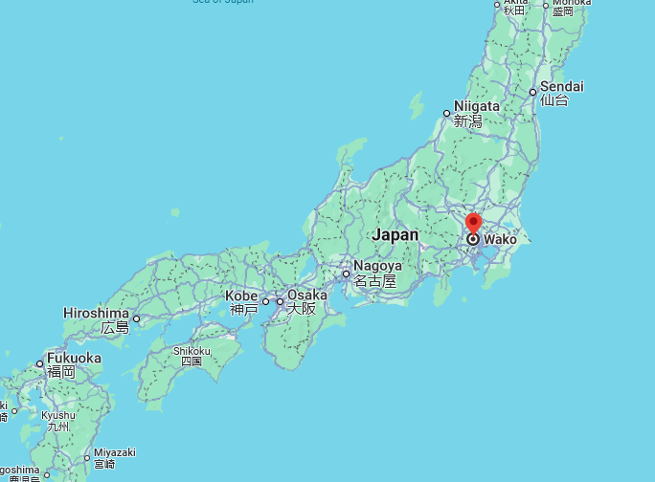
Summer Program Internship 2024
M1 Student at
IMT Mines Alès in France
Specializing in Computer Science and AI
I came to Japan to keep learning AI applications in a prestigious research center
2

Slide 3
Research Vision
Summer Program Internship 2024
The RIKEN MetaDatabase aggregates life-sciences metadata from over 130 research projects, following FAIR (Findable, Accessible, Interoperable, Reusable) principles.
Accessing this RDF-based data requires SPARQL query knowledge, which can be a barrier for researchers.
Biologists find writing SPARQL queries challenging due to the need for RDF and programming skills.
A system that converts natural language into SPARQL queries is needed to simplify access.
3

Slide 4
Research Goal and Strategy
Summer Program Internship 2024
Give access to semantic data to the user in natural language.
We aim to develop a user-friendly solution leveraging Large Language Models (LLMs) to automatically translate natural language queries (such as scientific questions) into SPARQL queries.
We choose LLMs because:
Allow interaction through natural language with the database instead of using specialized query languages.
Trainable tool that can learn with given examples.
4

Slide 5
Process flow to integrate LLM and SPARQL.
Summer Program Internship 2024
GOAL: Give access to semantic data to the user in natural language
USER
SYSTEM
Natural language question
LLM generates SPARQL query
Asks SPARQL endpoint
Metadata
SPARQL answer
Transformation of the result of the query with LLM
5

Slide 6
Question and associated SPARQL query
Summer Program Internship 2024
PREFIX dcterms: <http://purl.org/dc/terms/>
PREFIX efo: <http://www.ebi.ac.uk/efo/>
SELECT DISTINCT ?stage ?stageName ?stageDescription {
?stage rdf:type efo:EFO_0000399 . #developmental stage ?stage rdfs:label ?stageName .
?stage dcterms:description ?stageDescription .
}
What are the developmental stages present in Bgee?
LLM
6

Slide 7
Our approach to realize LLM for SPARQL query generation.
Summer Program Internship 2024
Local model (Llama 3.1 8B).
Fine tune a model available locally.
Closed-source model (GPT-4o).
Fine tune GPT-4o.
Prompt Engineering for direct prompting.
7

Slide 8
Prompt Engineering
Summer Program Internship 2024
Prompt binary variables |  |  | Evaluation metrics
Classes and properties | Counter examples | Examples | Y: BLEU, ROUGE, METEOR, String similarity
1 | 1 | 1 | …
1 | 1 | 0 | …
1 | 0 | 1 | …
1 | 0 | 0 | …
0 | 1 | 1 | …
0 | 1 | 0 | …
0 | 0 | 1 | …
0 | 0 | 0 | …
Other variable:
Difficulty of the query [1,0]
1 means that the element is present in the prompt.
0 means that it’s absent.
Model | BLEU | ROUGE precision | ROUGE recall | ROUGE F1 score | METEOR | String similarity %
GPT4o [1,1,1,1] | 0,68899844 | 0,94338624 | 0,80758808 | 0,87022042 | 0,7678474 | 0,67642276
Best result:
Biggest influence in the result:
70% Difficulty of the question
10% Classes and properties + Examples
Best results:
Common variable: Classes and properties
8

Slide 9
Prompt example [1,1,0,1]
Summer Program Internship 2024
Your task is to construct a SPARQL query that will provide the information to answer this question: What is all the metadata related to the ENSG00000130208 gene, where ENSG00000130208 is the identifier of the "APOC1" human gene? Please return only the query.
Here you have the list of classes and properties associated to the RDF database for which you have to generate queries:
term type label
http://www.w3.org/2002/07/owl#Thing class "Thing"
http://www.w3.org/2002/07/owl#Nothing class "Nothing"
http://purl.obolibrary.org/obo/CARO_0000000 class "anatomical entity"
http://purl.obolibrary.org/obo/CARO_0000000 class "anatomical entity"^^<http://www.w3.org/2001/XMLSchema#string>
…
[ ]
Here you have a correct example of the task you have to do:
Question: What are the species present in Bgee and their scientific and common names? SPARQL query:
PREFIX up: <http://purl.uniprot.org/core/>
SELECT ?species ?sci_name ?common_name {
?species a up:Taxon .
?species up:scientificName ?sci_name .
?species up:rank up:Species .
OPTIONAL { ?species up:commonName ?common_name . }
}
1
1
0
1
9

Slide 10
Fine tuning
Summer Program Internship 2024
RIKEN training data set
For each dataset
Natural Language Question
+
Associated SPARQL query
Size: 0 elements available
Necessary for fine tuning
Generate synthetic sets of natural language questions and their respective SPARQL queries.
Future work: Ask researchers to progressively provide queries and their associated questions.
Bgee training data set
For each dataset
Natural Language Question
+
Associated SPARQL query
+
(Classes and properties)
Size: 12 elements extended to 60
10

Slide 11



Synthetic data generation
Summer Program Internship 2024
4) Create prompt
with the schema
TBOX and ABOX (schema)
Dataset creation Prompt
1) Select one
Database DB
Schema
Query for DB
3) Get schema
triplets
Chat GPT API
2) Execute query
5) Ask API to propose
Question and SPARQL
queries
Questions –SPARQL pairs of DB.
6) Save proposed
data
7) Execute proposed queries,
get results
Dataset
Filtered Dataset
8) Keep only pairs that return results.
11

Slide 12
Fine tuning
Summer Program Internship 2024
Metrics
 | Model | BLEU | ROUGE precision | ROUGE recall | ROUGE F1 score | METEOR | String similarity % | % Exact matches | Working queries
Closed source model | GPT4o 30 + classes | 0.7589 | 0.8184 | 0.7982 | 0.8023 | 0.8079 | 70.63% | 0% | 66.67%
 | GPT4o mini 60 + classes | 0.6752 | 0.8107 | 0.7681 | 0.7822 | 0.7414 | 76.34% | 16,67% | 66.67%
Open source local model | Llama 3.1 Riken | 0.3505 | 0.7070 | 0.7246 | 0.7009 | 0.4593 | 71.85% | 42.3%
When comparing models:
GPT-4o and GPT-4o mini are in average twice as good as Llama.
Between GPT-4o and GPT-4o mini: GPT-4o is 5% better in average.
When comparing strategies:
Adding classes and properties performs 22% better than not adding them in the prompt.
For the Bgee dataset the difference in performance between the 30 examples dataset and 60 examples dataset is minimal.
12

Slide 13
Summary
Summer Program Internship 2024
Best performance:
-Fine tune GPT-4o with a dataset that takes into account the classes and properties.
-We show that with a limited number of examples we can achieve great results. (almost 70% of generated queries work).
-Direct prompt for simple queries adding examples and the classes and properties in the prompt has a comparable performance, but for more complex queries the performance drops considerabily.
Future work:
-Try other techniques as entity linking, RAG, OBQC-LLM repair.
-Ask researchers to provide a natural language question with each query they submit.
-Explore the possibility of automatically generating new RDF-triples (metadata).
13

Slide 14
Acknowledgements
Summer Program Internship 2024
Julio Rangel-san
Norio Kobayashi-sensei
Unit staff
THANK YOU
14

Slide 15
Summer Program Internship 2024
Annexes

Slide 16
Fine tuning Local Model (LLama 3.1 8B)
Summer Program Internship 2024
 | BLEU | ROUGE precision | ROUGE recall | ROUGE F1 score | METEOR | String match % | % Exact matches | Working queries
Llama 3.1 30+classes | 0.0077 | 0.0530 | 0.2252 | 0.0798 | 0.0260 | 4.04% | 0% | 0/126
Llama 3.1 30 | 0.2690 | 0.7707 | 0.7034 | 0.7247 | 0.3804 | 66.88% | 0% | 3/6
Llama 3.1 60+classes | 0.0128 | 0.0887 | 0.3521 | 0.1379 | 0.0382 | 4.96% | 0% | 0/126
Llama 3.1 60 | 0.3308 | 0.8206 | 0.7708 | 0.7760 | 0.4303 | 62.58% | 0% | 6/12
Llama 3.1 Riken | 0.3505 | 0.7070 | 0.7246 | 0.7009 | 0.4593 | 71.85% | 11/126
Q1 prompt | 0,47313837 | 0,71155205 | 0,66056911 | 0,68144173 | 0,57641864 | 0,54371566
Q2 prompt | 0,12761682 | 0,58640977 | 0,31017567 | 0,40041394 | 0,23984364 | 0,3488872
9

Slide 17
Fine tuning Private Model GPT
Summer Program Internship 2024
 | BLEU | ROUGE precision | ROUGE recall | ROUGE F1 score | METEOR | String match % | % Exact matches | Working queries
GPT4o 30 + classes | 0.7589 | 0.8184 | 0.7982 | 0.8023 | 0.8079 | 70.63% | 0% | 4/6
GPT 4o 30 | 0.7259 | 0.8604 | 0.7485 | 0.7910 | 0.7845 | 72.49% | 0% | 2/6
GPT4o 60 + clases | 0.7057 | 0.8505 | 0.7941 | 0.8104 | 0.7748 | 76.26% | 16,67% | 7/12
GPT 4o 60 | 0.6130 | 0.7127 | 0.6631 | 0.6765 | 0.6944 | 67.17% | 0% | 4/12
GPT4o Riken | 0.4336 | 0.6696 | 0.6481 | 0.6424 | 0.5606 | 66.09% | 7,14%
GPT4o mini 30 + classes | 0.7045 | 0.8395 | 0.7768 | 0.7910 | 0.7864 | 71.09% | 16,67% | 2/6
GPT4o mini 30 | 0.6073 | 0.7561 | 0.6605 | 0.6992 | 0.6661 | 67.54% | 0% | 2/6
GPT4o mini 60 + classes | 0.6752 | 0.8107 | 0.7681 | 0.7822 | 0.7414 | 76.34% | 16,67% | 8/12
GPT4o mini 60 | 0.5780 | 0.6504 | 0.6967 | 0.6596 | 0.6775 | 65.53% | 8,33% | 5/12
GPT4o mini Riken | 0.4610 | 0.6871 | 0.6780 | 0.6657 | 0.5868 | 67.83% | 7,93%
8

Slide 18
Prompt Engineering
Summer Program Internship 2024
To improve Prompt:
Design of Experiement
Evaluation:
Syntax, functionality, Ontology-based Query Check (OBQC)-LLM Repair
INCREASING THE LLM ACCURACY FOR QUESTION ANSWERING: ONTOLOGIES TO THE RESCUE! LLM Repair Query Check (OBQC)
80% Acc
9

Slide 19
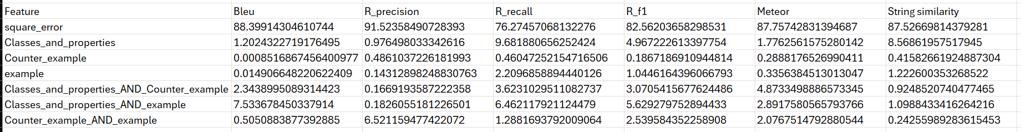
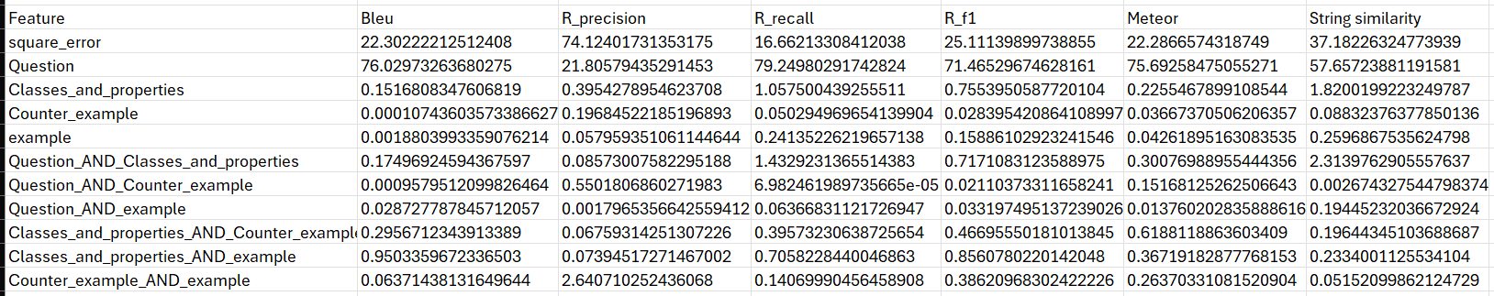
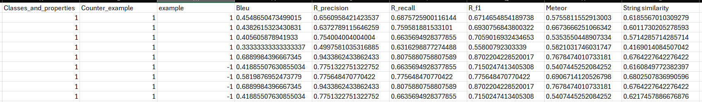
Prompt Engineering
Summer Program Internship 2024
10

